Slide 1
Bank customer churn prediction
Mani Barathi SP S (1832031)
Rekha V S (1832042)

Slide 2
Objective

Slide 3
Tools
Machine Learning
Pythonanywhere
Data Privacy – AES for feature encryption
Flask
HTML CSS

Slide 4
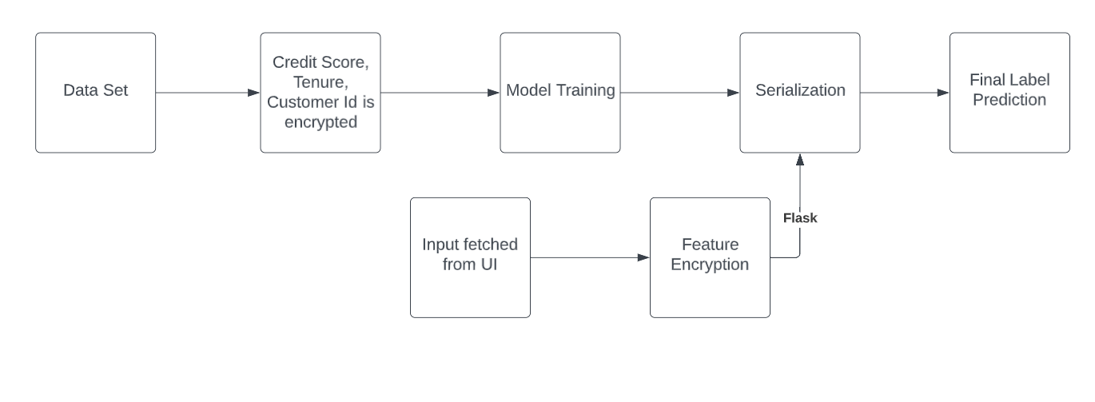
Model Flow

Slide 5
Work Flow
Important features (Customer ID, Tenure, Credit Score) are encrypted using AES algorithm.
Encrypted data is trained using ML models, best fit model is serialized for prediction.
Simple user friendly web UI is developed using HTML/CSS.
Input fetched from user hits backend model by using flask framework.
Before Prediction, features like Customer ID, Tenure, Credit Score is encrypted. Finally, Predicted results is rendered to the user.

